Slide 1
BCD Adder

Slide 2
BCD Adder
When the sum of two digits is less than or equal to 9 then the ordinary 4-bit adder can be used
But if the sum of two digits is greater than 9 then a correction must be added “I.e adding 0110”
We need to design a circuit that is capable of doing the correct addition

Slide 3
BCD Adder
The cases where the sum of two 4-bit numbers is greater than 9 are in the following table:
S4 | S₃ | S₂ | S₁ | S₀
0 | 1 | 0 | 1 | 0 | 10
0 | 1 | 0 | 1 | 1 | 11
0 | 1 | 1 | 0 | 0 | 12
0 | 1 | 1 | 0 | 1 | 13
0 | 1 | 1 | 1 | 0 | 14
0 | 1 | 1 | 1 | 1 | 15
1 | 0 | 0 | 0 | 0 | 16
1 | 0 | 0 | 0 | 1 | 17
1 | 0 | 0 | 1 | 0 | 18

Slide 4
BCD Adder
Whenever S₄=1 (sums greater than 15)
Whenever S₃=1 and either S₂ or S₁ or both are 1 (sums 10 to 15)
The previous table can be expressed as:
X = S₄ + S₃ ( S₂ + S₁)
So, whenever X = 1 we should add a correction of 0110 to the sum.

Slide 5
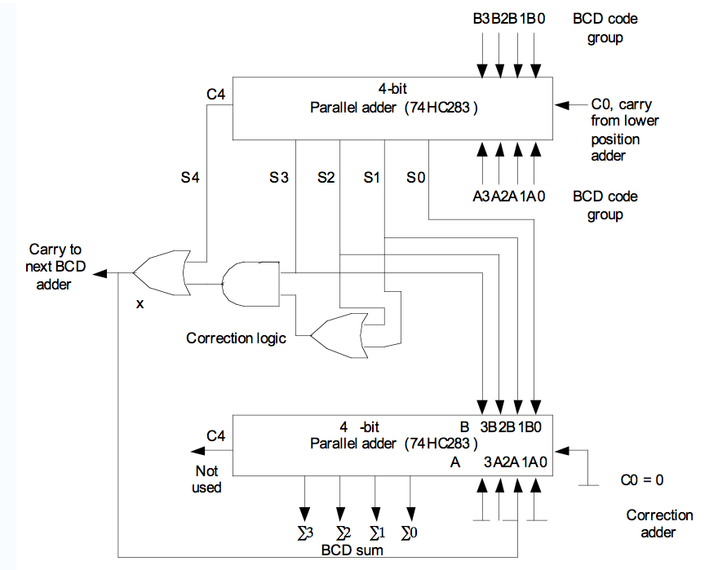
Inputs:[A]=0101, [B]= 0011, C_{o}=0
0011
0101
0 1 0 0 0
0
0
0
1000
1
1 0 0 0
0000

Slide 6
Inputs:[A]=0111, [B]= 0110, C_{o}=0
0110
0111
0 1 1 0 1
1
1
1
1101
1
0 0 1 1
0110

Slide 7
Cascading BCD Adders
The previous circuit is used for adding two decimal digits only. That is, “ 7 + 6 = 13”.
For adding numbers with several digits, a separate BCD adder for each digit position must be used.
For example:
2 4 7
5 3 8 +
--------------------
?
BCD Adder
BCD Adder
BCD Adder

Slide 8
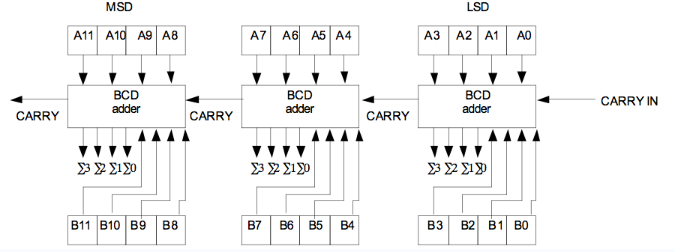
Cascading BCD Adders

Slide 9
Example
Determine the inputs and the outputs when the above circuit is used to add 538 to 247. Assume a CARRY IN = 0
Solution:
  Represent the decimal numbers in BCD
    247 = 0010 0100 0111
    538 = 0101 0011 1000
    Put these numbers in registers [A] and [B]
    [A] = 0010 0100 0111
    [B] = 0101 0011 1000

Slide 10
Example
0 0 1 0
0 1 0 0
0 1 1 1
0
0
1
0
0111
1000
0101
0 1 0 1
0 0 1 1
1 0 0 0

